Slide 1

ECG TEST

Slide 2
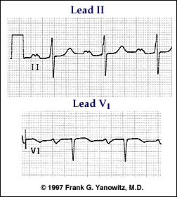

Slide 3
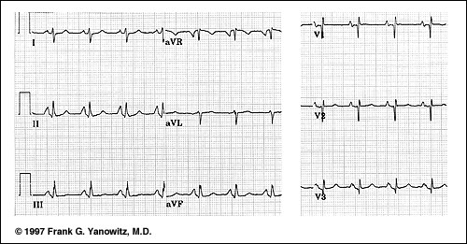

Slide 4
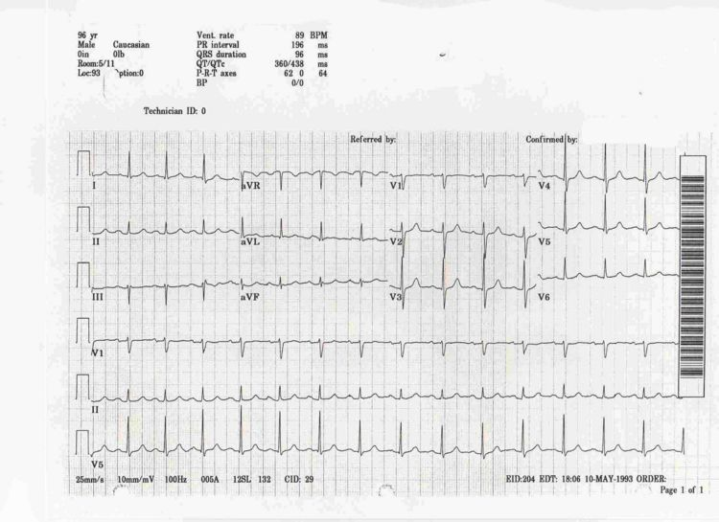

Slide 5
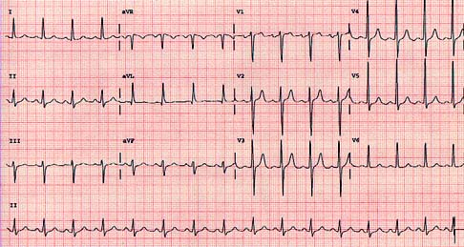

Slide 6
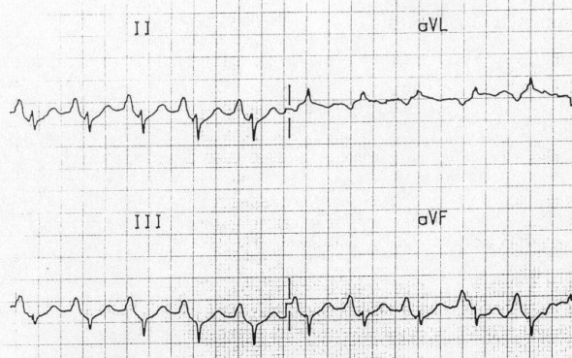

Slide 7
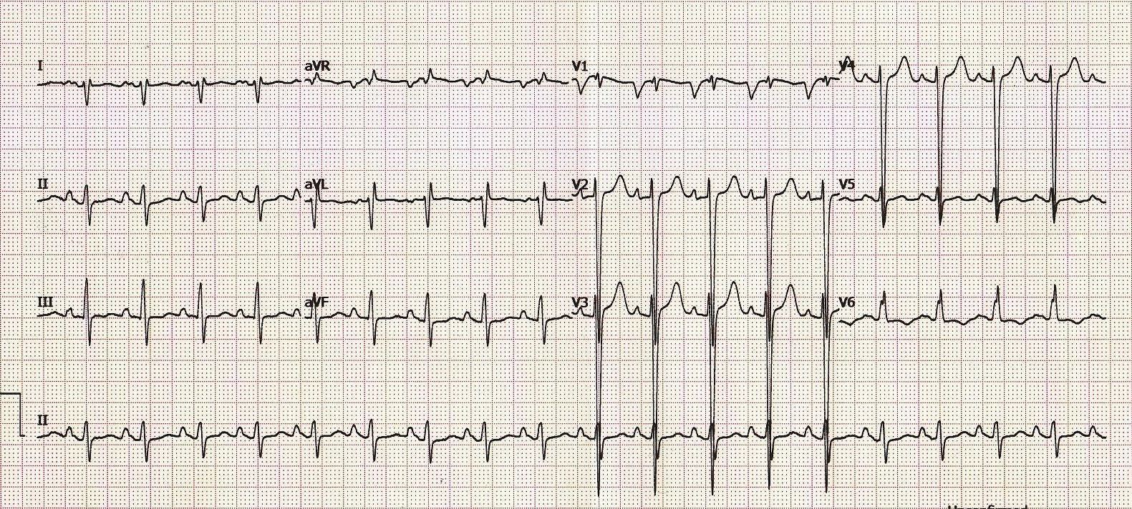
Notes:
There is marked LVH (S wave in V2 > 35 mm) with dominant S waves in V1-4.
Right axis deviation suggests associated right ventricular hypertrophy (i.e. biventricular enlargement).
There is evidence of left atrial enlargement (deep, wide terminal portion of the P wave in V1).
There are peaked P waves in lead II suggestive of right atrial hypertrophy (not quite 2.5mm in height).

Slide 8
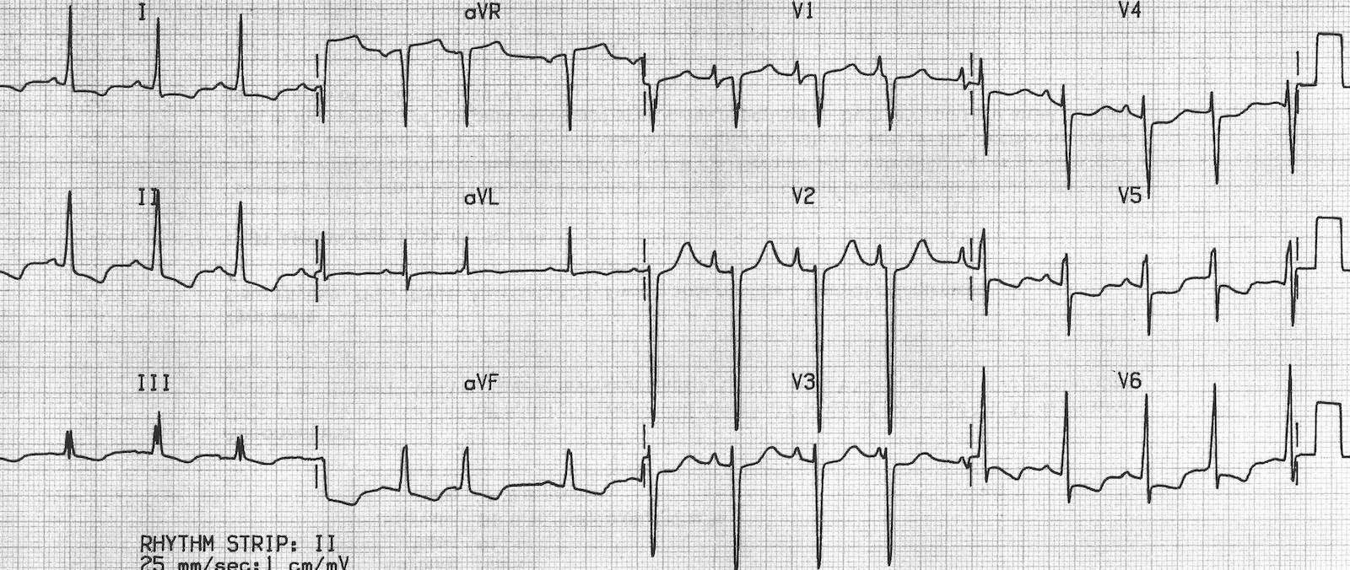
Notes:
There is evidence of left ventricular hypertrophy with large precordial voltages and an LV strain pattern in leads with a dominant R wave (I, II, V6).
There is also evidence of biatrial enlargement in V1 with a peaked initial portion of the P wave (RAE) followed by a deep terminal negative portion (LAE).
The changes of right ventricular hypertrophy are masked by left ventricular dominance; however, this patient had four-chamber dilatation on echocardiography.

Slide 9
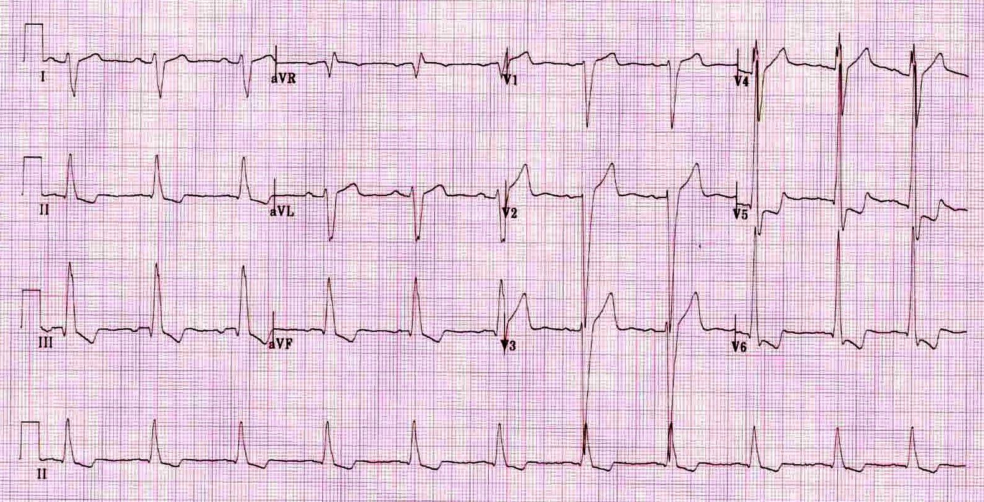
Notes:
There is marked left ventricular hypertrophy with repolarisation abnormality (LV “strain” pattern) in V5-6.
LV dilatation has produced an interventricular conduction delay mimicking LBBB — however, this is not LBBB as the morphology is not typical and there are small Q waves in V5-6 (the presence of Q waves in V6 rules out LBBB).
There are some signs of left atrial enlargement — leftward deviation of the P wave axis (positive P waves in I and aVL, inverted in III and aVF) and prolongation of the terminal portion of the P wave in V1.
Right axis deviation in the presence of LVH suggests the possibility of biventricular enlargement.
The widespread downsloping ST depression may be due to LVH (= “appropriate discordance”) or digoxin effect (a commonly used mediation in congestive cardiac failure).

Slide 10
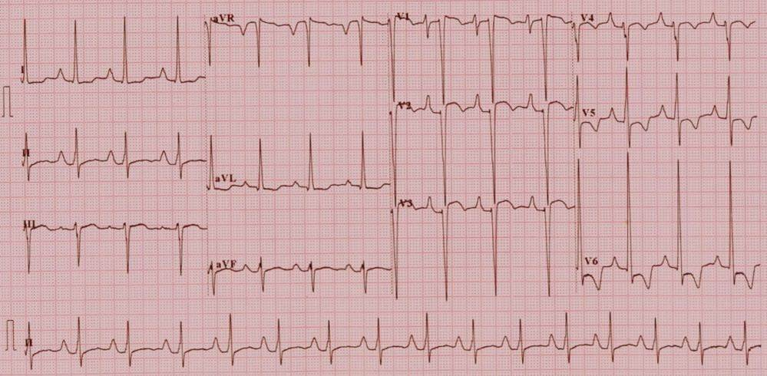
Notes:
Tricupsid atresia ECG

